Slide 1
EMPLOYEE MANAGEMNET APP

Slide 2
DESCRIPTION
•The program evaluates the company's profit or loss percentage in each component by letting its employees choose their work shift times based on their personal preference.
• The database will hold the entire data of the program which will help its users to organize and manage things more easily. Instead of inserting the data manually each time the program runs, extracting and inserting information from the tables will increase the company's efficiency.
•The users of the database are the company's managing positions. The department managers, for instance, can easily access the tables which represent their department and its employees.

Slide 3
USERS
MANAGERS
ACCOUNTANS
Who can organize and control the human resources
Who wants to calculate efficiencies for companies

Slide 4



ENTITIES
Department
Role
Employee
BaseEmployee
HourlyEmployee
BaseAndSalesEmployee
Holds the data regarding the roles which belong to the specific department
Holds the data regarding the employees which belong to the specific role
Holds the data regarding an employee attributes
Gets fixed salary
Gets fixed salary and percentage from monthly sales
Gets paid per hour

Slide 5
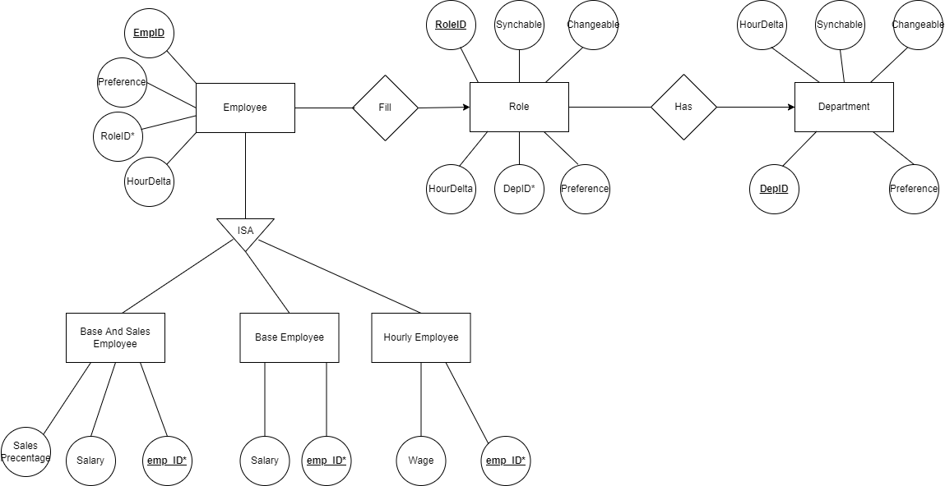
ERD

Slide 6
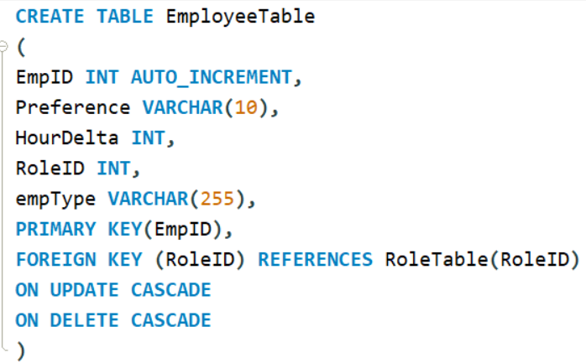
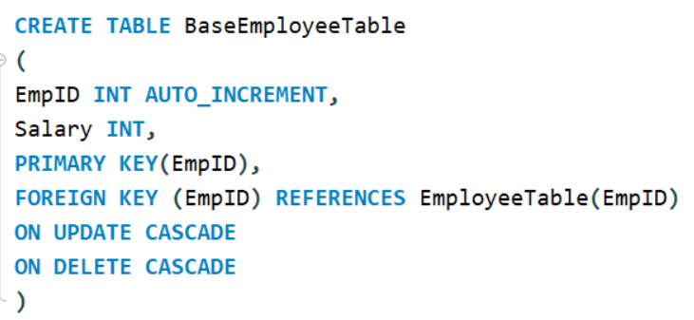
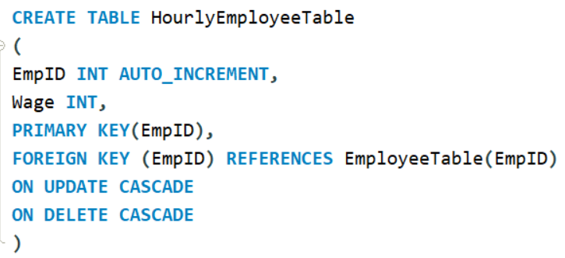
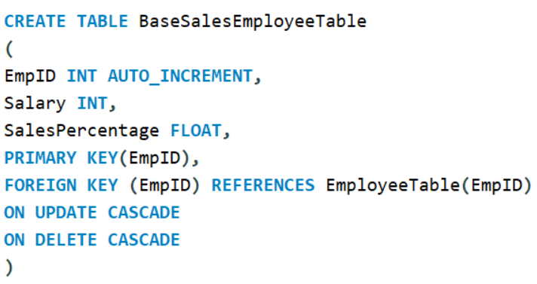
CREATE EMPLOYEE TABLES

Slide 7
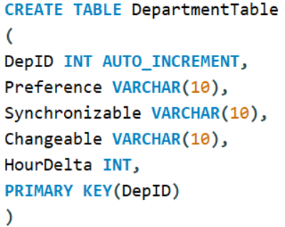
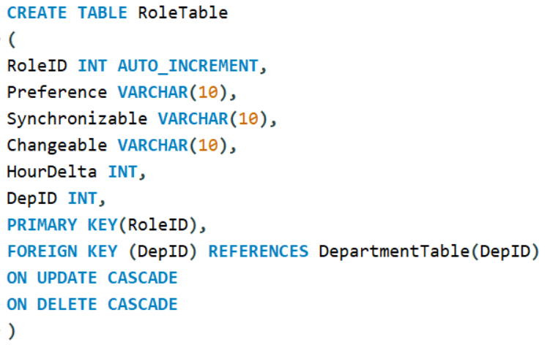
CREATE ROLE AND DEPARTMENT TABLES

Slide 8
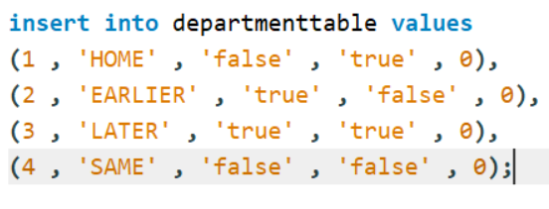
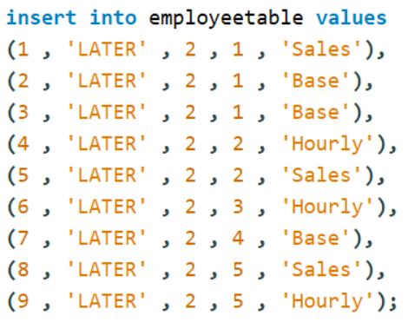
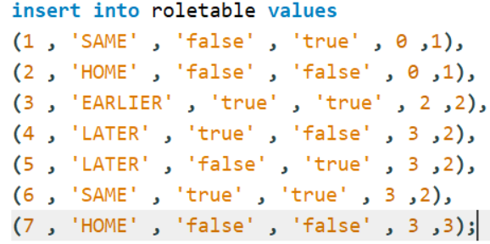
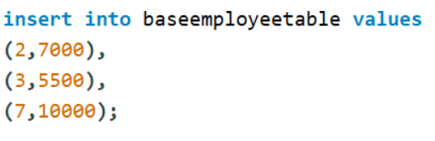
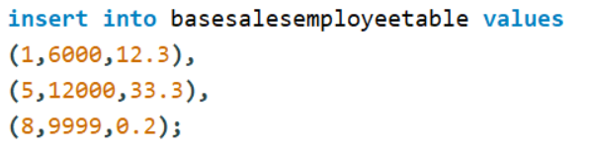
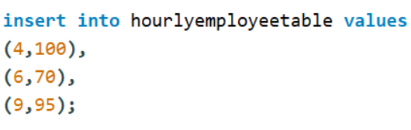
INSERTION COMMANDS

Slide 9
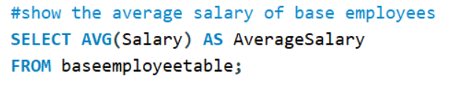
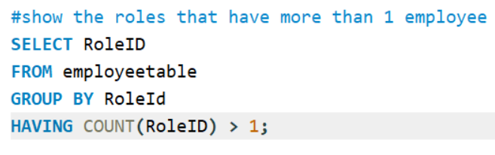
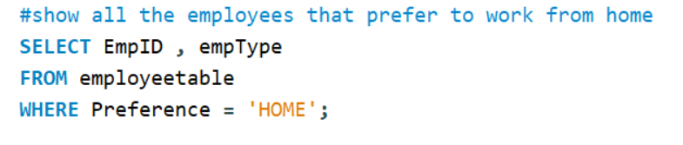
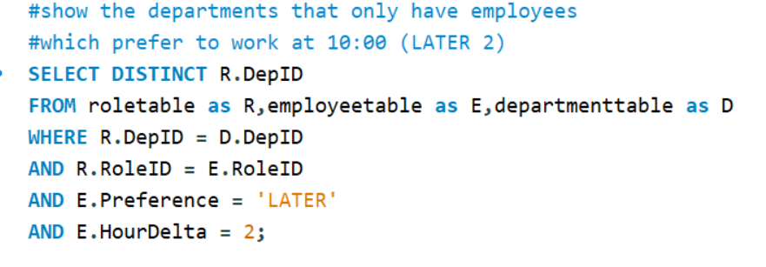
SELECT STATEMENTS

